Slide 1
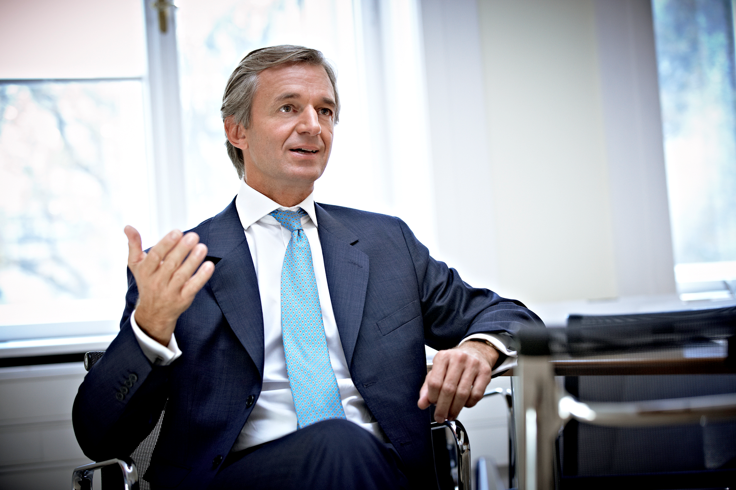
Key Developments
Appoints Dr. Andreas Blaschke as Independent Director – Significantly Strengthens Board Expertise
Dr. Andreas Blaschke, aged 61 years, a Doctor of Laws from University of Vienna, and Master of Business Studies from Vienna University of Business Administration & Economics
Has played a leadership role in a leading European Packaging Company. With over 3 decades of experience he brings a wealth of knowledge and expertise to the Board

Slide 2
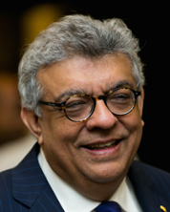
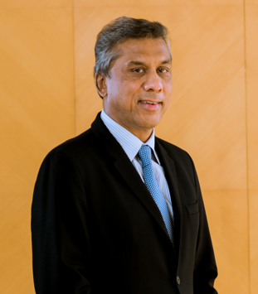
Key Developments
Strengthening the Board with the Addition of Two New Independent Directors
Sanjiv Anand’s Appointment
Mr. Sanjiv Anand, a globally recognized thought leader on strategy powered by the Balanced Scorecard, has been appointed as an Independent Director. As the Chairman of Cedar, a Forbes ranked global consulting firm, he brings a wealth of strategic expertise.
With a rich history spanning over 35 years, Mr. Anand has helped Boards, CEO & leadership teams in the development of their strategy and the transformation of their business practices. He has worked with a diverse portfolio of prestigious clients, including those in the packaging sector
Tarang Jain’s Appointment
Mr. Tarang Jain, Chairman and Managing Director of Varroc Engineering Limited, joins the board as an Independent Director. He brings to TCPL’s board a strategic vision that has propelled Varroc into a global tier-1 automotive component group, demonstrating his capacity for driving significant international expansion and innovation in technology.
With over 35 years of leadership experience, his tenure is marked by strong values of integrity and a commitment to corporate social responsibility, illustrated by Varroc’s active role in environmental initiatives
2

